Slide 1


JOSLIN IYDA.J
20.09.2024

Slide 2

Outline
Executive Summary
Introduction
Methodology
Results
Conclusion
Appendix

Slide 3
Executive Summary
This capstone project focuses on predicting the success of Falcon 9 first stage landings using data science and machine learning. SpaceX's launch services, priced at $62 million, are significantly lower than competitors, highlighting the importance of successful landings for cost efficiency.
Historical launch data is analyzed through preprocessing, exploratory data analysis (EDA), and predictive modeling using various algorithms, including Logistic Regression, SVM, Decision Trees, and KNN. Hyperparameter optimization is performed using GridSearchCV to identify the best-performing model.
The project culminates in a detailed report and interactive visualizations with Folium and Plotly Dash, providing insights for stakeholders and potential competitors. This work underscores the economic benefits of data-driven decision-making in the aerospace industry.

Slide 4
Introduction
In this capstone project, the prediction of the success of the Falcon 9 first stage landing is undertaken using data science techniques and machine learning algorithms. With SpaceX's Falcon 9 rocket launch services priced at $62 million—significantly lower than competitors—predicting landing outcomes is aimed at enhancing operational efficiency and informing pricing strategies.
Historical launch data is leveraged to analyze various features that influence landing success, employing preprocessing, exploratory data analysis (EDA), and predictive modeling.
The approach involves data collection from SpaceX's launch records, followed by rigorous data wrangling to prepare the dataset for analysis. Multiple machine learning algorithms, including Logistic Regression, Support Vector Machine (SVM), Decision Trees, and K-Nearest Neighbors (KNN), are utilized to identify the best-performing model. Through techniques such as GridSearchCV, hyperparameters are optimized and model accuracy is validated.

Slide 5


Slide 6
Methodology
Data Collection
Data was collected from SpaceX’s launch records, encompassing various attributes such as launch dates, sites, payloads, and outcomes. This dataset was sourced from publicly available CSV files, which provided a comprehensive history of Falcon 9 launches.
Data Wrangling
The data underwent several processing steps, including :
cleaning and normalization.
Missing values were addressed, and
categorical variables were encoded for analysis.
Feature engineering was applied to create relevant features that would enhance model performance, such as extracting relevant time components from launch dates.

Slide 7
Methodology
Exploratory Data Analysis (EDA)
EDA involved using visualizations to uncover patterns and trends within the dataset.
Charts and graphs were created using libraries like Matplotlib and Seaborn
SQL queries to perform aggregations and generate insights on launch success rates, payload distributions, and site performance.
Interactive Visual Analytics
Interactive visualizations were developed using Folium for mapping launch sites and Plotly Dash for creating dynamic dashboards. These tools allowed users to explore data through intuitive interfaces, enabling them to view launch outcomes, payloads, and other metrics interactively.
Predictive Analysis
The project employed various classification models, including Logistic Regression, Support Vector Machines, Decision Trees, and K-Nearest Neighbors. Each model was built, tuned, and evaluated using GridSearchCV to optimize hyperparameters. Performance metrics such as accuracy, precision, and recall were calculated to assess model effectiveness, and confusion matrices were used to visualize classification results.

Slide 8
Data Collection
Data Source Identification: The primary source for data was the SpaceX official website.
Data Extraction: Structured data was obtained using SpaceX's APIs, while unstructured data was extracted from the website using Python's Beautiful Soup library.
Data Cleaning: Missing values were imputed using techniques like mean, and inconsistencies were corrected to ensure data consistency across different sources.
Data Transformation: The data was converted to a standard CSV format, and new features were engineered to enhance analysis.
SpaceX Website
Data Source
SpaceX API Extract Data
Data Cleaning
Data Transformation and Storage

Slide 9
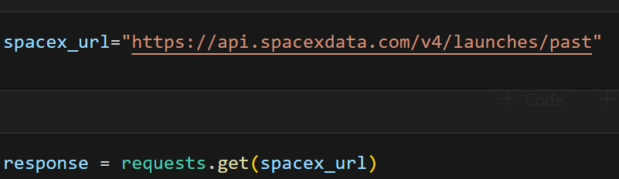
Data Collection – SpaceX API
Identify SpaceX API Endpoints
Set Up API Call
Execute API Request
GitHub Link:
DS_SpaceX/Data Collection/jupyter-spacex-data-collection-api.ipynb at main · josliniyda27/DS_SpaceX (github.com)
Receive API Response (JSON Format)
Parse JSON Data (Extract Relevant Fields)
Store Data in Pandas DataFrame

Slide 10
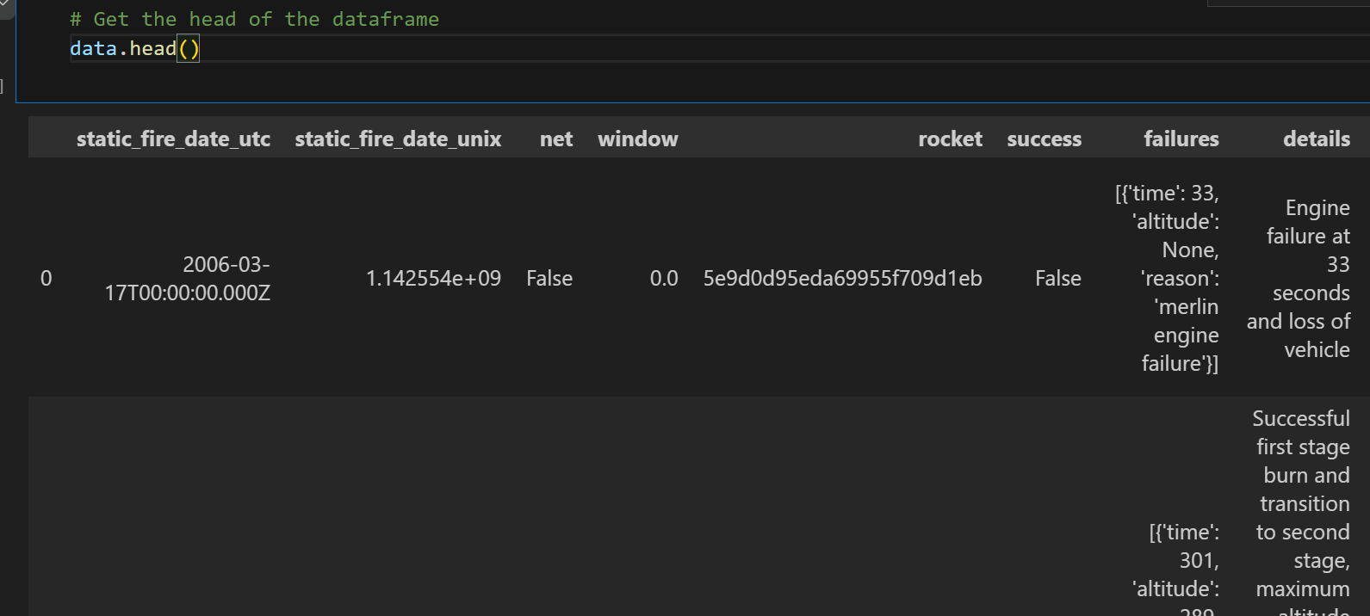
Dataset Stored in Pandas DataFrame

Slide 11
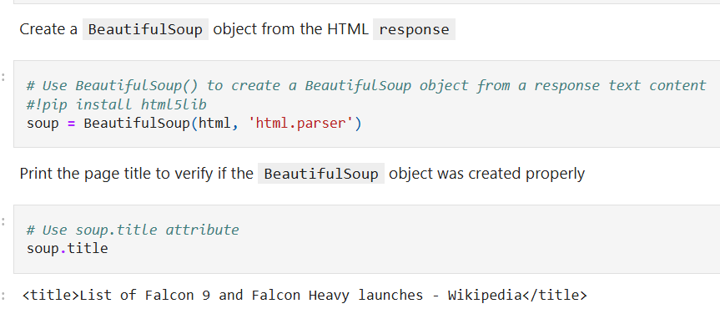
Data Collection - Scraping
Request the Falcon9 Launch Wiki page
Extract all column/variable names
Dataset: List of Falcon 9 and Falcon Heavy launches – Wikipedia
GitHub URL: DS_SpaceX/Data Collection/jupyter-webscraping.ipynb at main · josliniyda27/DS_SpaceX (github.com)
Create a data frame by parsing the launch HTML tables

Slide 12
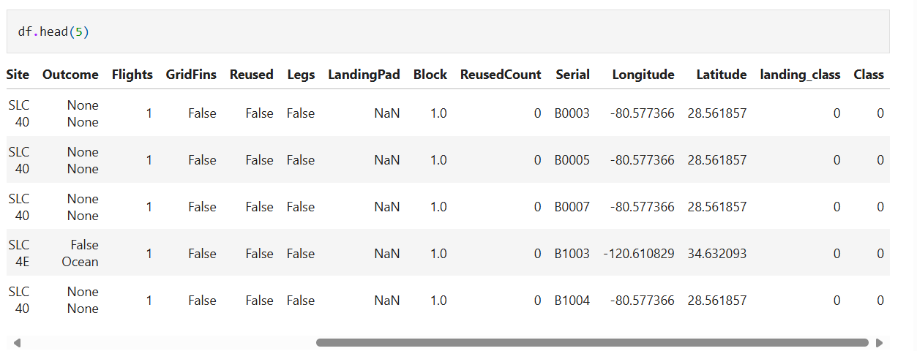
Data Wrangling
The number of launches on each site is calculated,
The landing outcome label is created from Outcome column and added into the dataset
GitHub URL:
DS_SpaceX/Data Wrangling/jupyter-spacex-Data wrangling.ipynb at main · josliniyda27/DS_SpaceX (github.com)

Slide 13
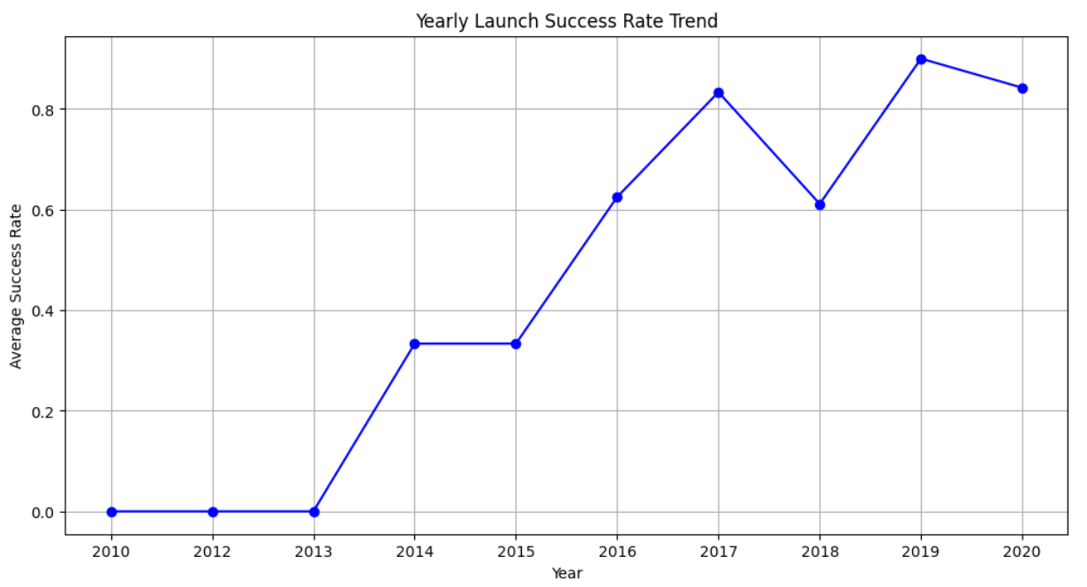
EDA with Data Visualization
Visualized the relationship between different features such as Flight Number and Launch Site, Payload Mass and Launch Site, success rate and orbit type, FlightNumber and Orbit type, Payload Mass and Orbit type, and the launch success yearly trend using scatter plot, bar plot and line chart.
GitHub URL:
DS_SpaceX/Exploratory Data Analysis/eda-data-visualization-python.ipynb at main · josliniyda27/DS_SpaceX (github.com)

Slide 14
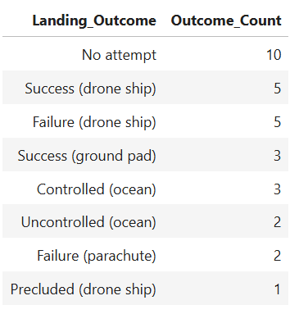
EDA with SQL
Displayed the names of the unique launch sites in the space mission and displayed 5 records where launch sites begin with the string 'CCA'
Displayed average payload mass carried by booster version F9 v1.1 and listed the date when the first succesful landing outcome in ground pad was acheived.
Listed the names of the boosters which have success in drone ship and have payload mass greater than 4000 but less than 6000
Listed the total number of successful and failure mission outcomes and the names of the booster_versions which have carried the maximum payload mass. Use a subquery
Displayed the month names, failure landing_outcomes in drone ship ,booster versions, launch_site for the months in year 2015.
Ranked the count of landing between the date 2010-06-04 and 2017-03-20, in descending order.
GitHub URL:
DS_SpaceX/Exploratory Data Analysis/jupyter-sql-sqllite-exploratory-data-analysis.ipynb at main · josliniyda27/DS_SpaceX (github.com)

Slide 15
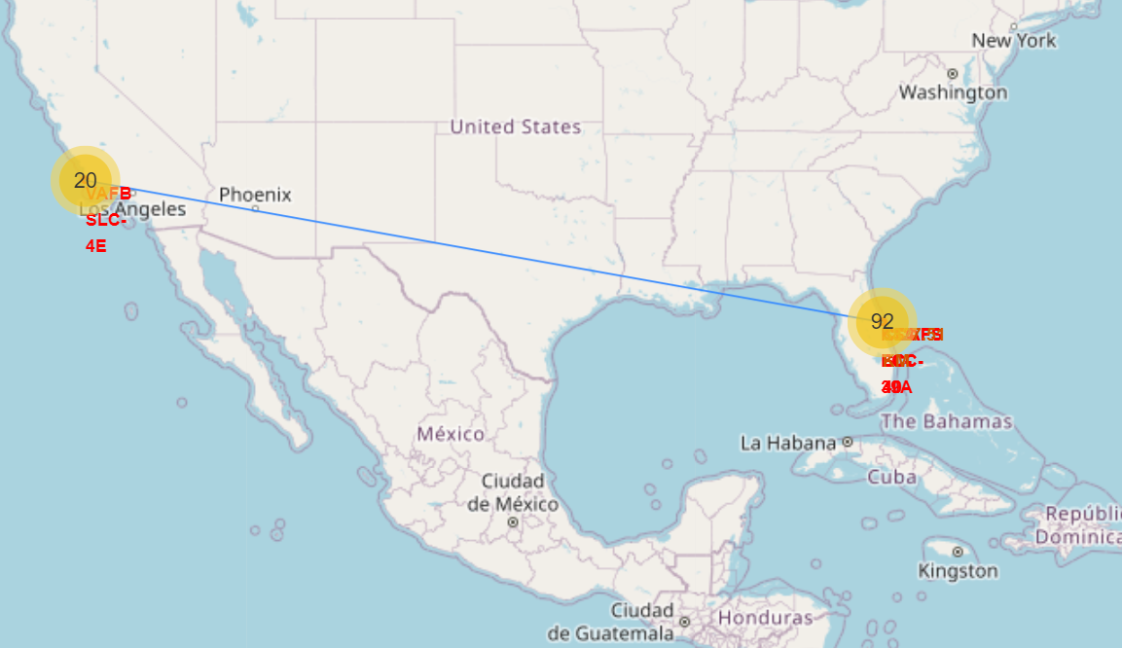
Build an Interactive Map with Folium
To find an optimal location for building a launch site
Marked all launch sites on a map
Marked the success/failed launches for each site on the map
Calculated the distances between a launch site to its proximities
GitHub URL:
DS_SpaceX/Data Analysis/jupyter_launch_site_location.ipynb at main · josliniyda27/DS_SpaceX (github.com)

Slide 16
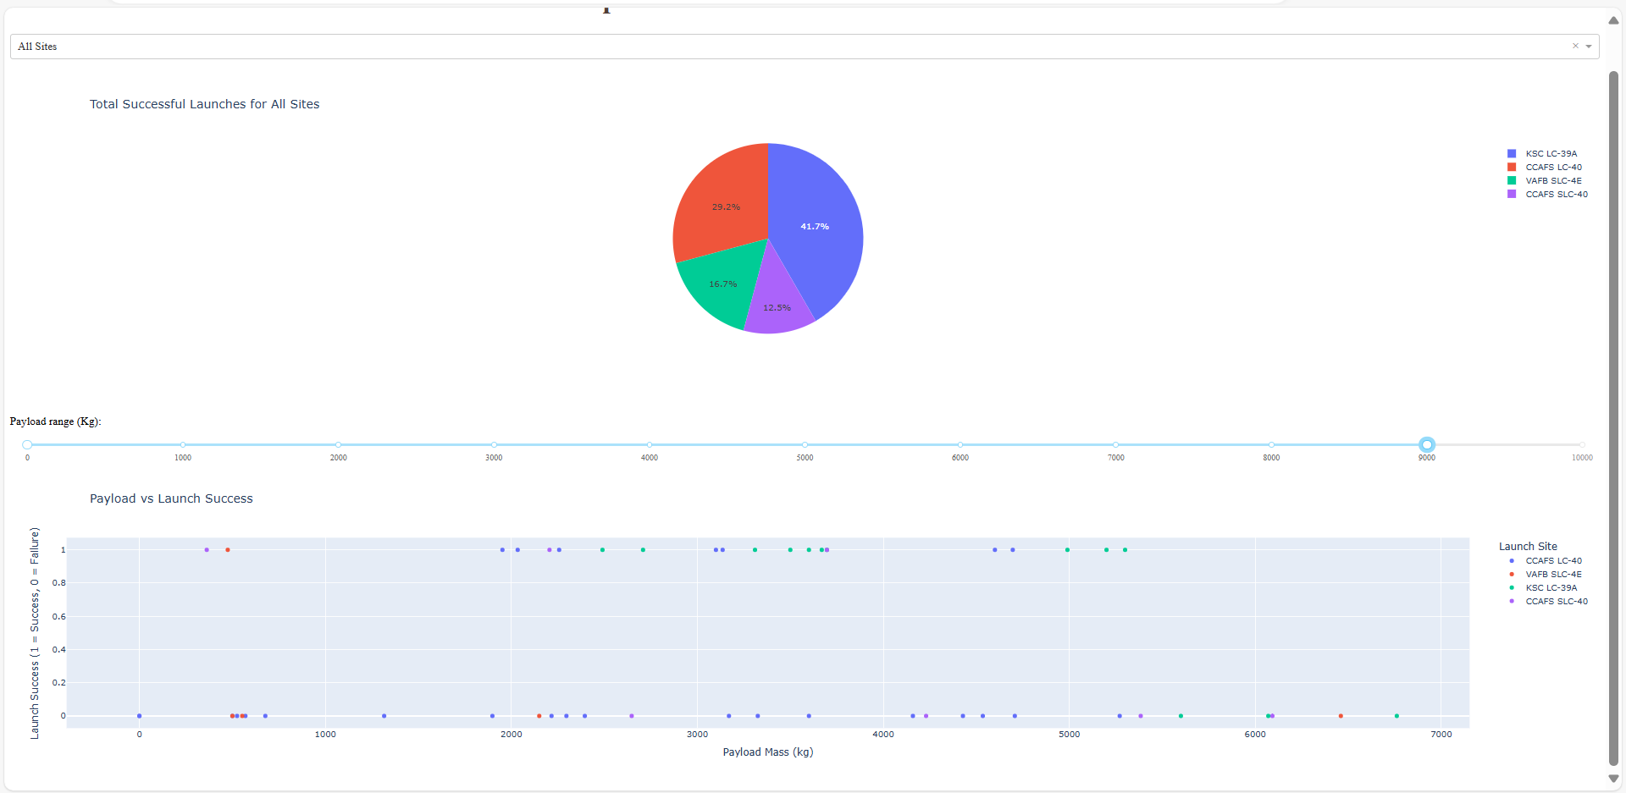
Build a Dashboard with Plotly Dash
Added a Launch Site Drop-down Input Component
Added a callback function to render success-pie-chart based on selected site dropdown
Added a Range Slider to Select Payload
Added a callback function to render the success-payload-scatter-chart scatter plot
GitHub URL
DS_SpaceX/Data Analysis/spacex_dash_app.py at main · josliniyda27/DS_SpaceX (github.com)

Slide 17
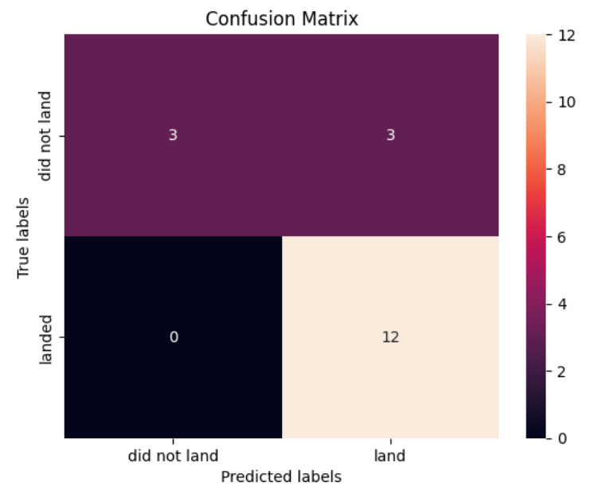
Predictive Analysis (Classification)
Performed exploratory Data Analysis and determined Training Labels
Created a column for the class and standardized the data
Splitted dataset into training data and test data
Best Hyperparameter for SVM, Classification Trees and Logistic Regression models are identified.
Based on the best parameters the best model which classify the dataset is applied.
GitHub URL
DS_SpaceX/ML_Prediction/SpaceX_Machine Learning Prediction.ipynb at main · josliniyda27/DS_SpaceX (github.com)

Slide 18
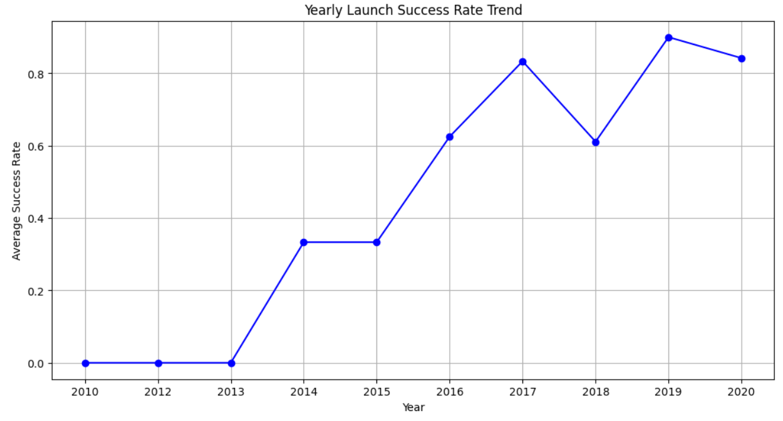
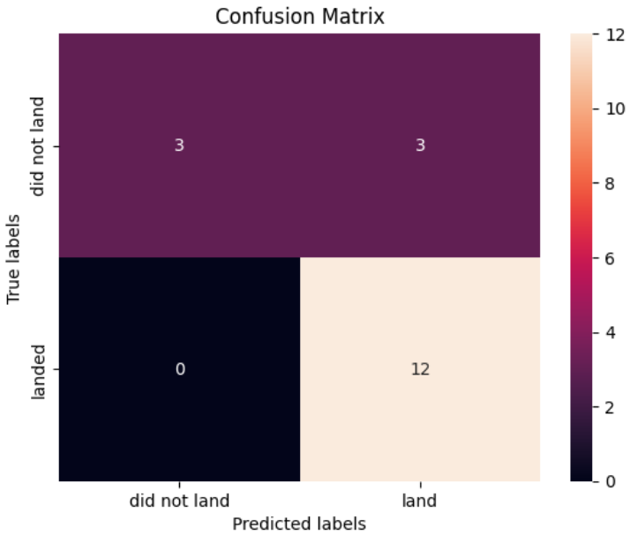
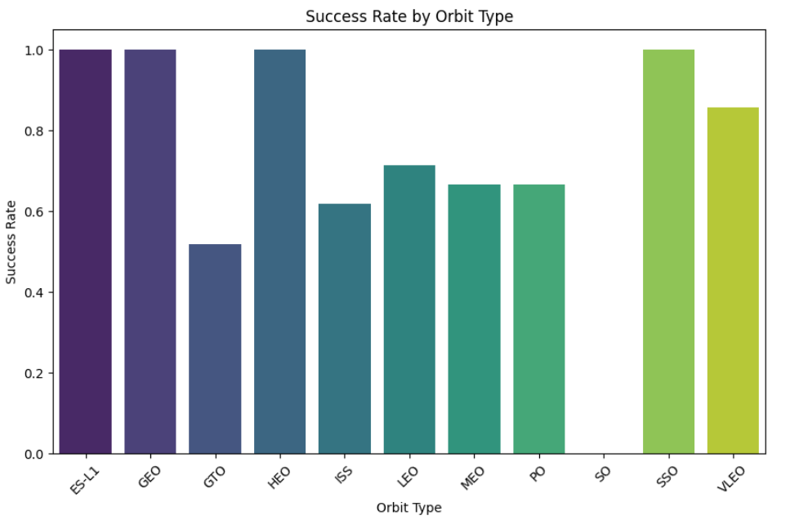
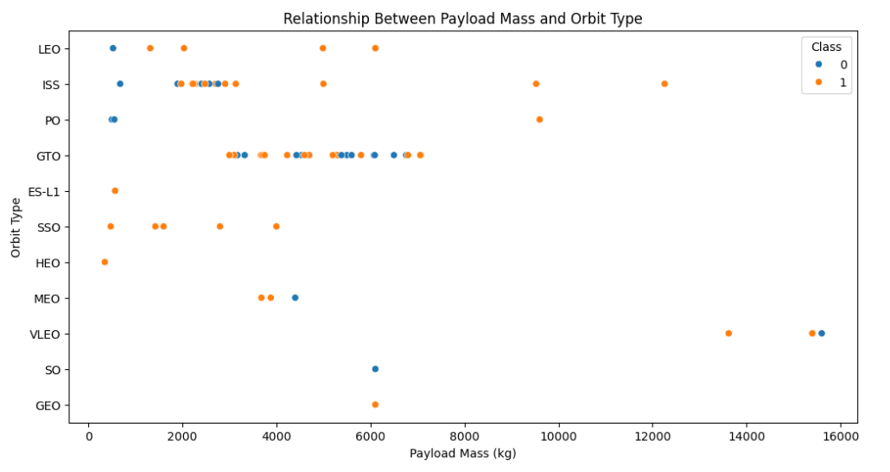
Results

Slide 19

Section 2

Slide 20
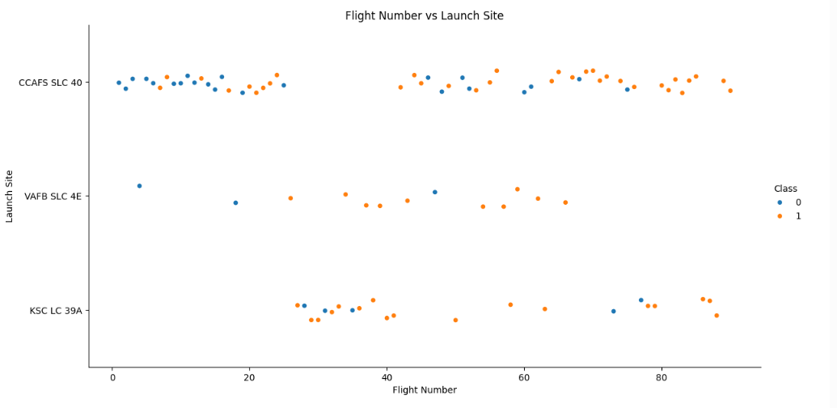
Flight Number vs. Launch Site
The chart shows a clear relationship between Flight Number and Launch Site. As the Flight Number increases, the Launch Site shifts from CCAFS SLC 40 to VAFB SLC 4E, and then to KSC LC 39A. This pattern suggests that SpaceX may have been using different launch sites for different missions or phases of their space program.
The chart suggests that SpaceX has used a variety of launch sites over time, possibly due to factors such as mission requirements, availability of launch pads, and cost considerations.

Slide 21
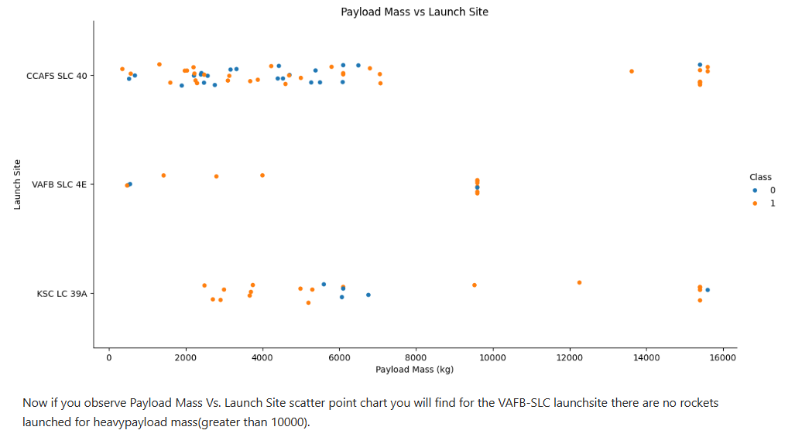
Payload vs. Launch Site

Slide 22
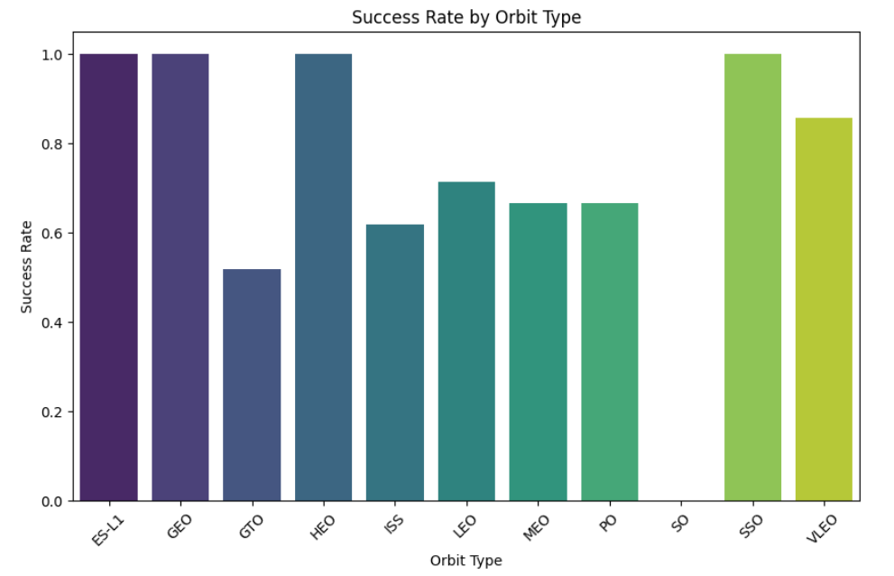
Success Rate vs. Orbit Type
Factors such as the distance from Earth, the complexity of the orbit, and the amount of debris in the orbit can all contribute to the success rate.

Slide 23
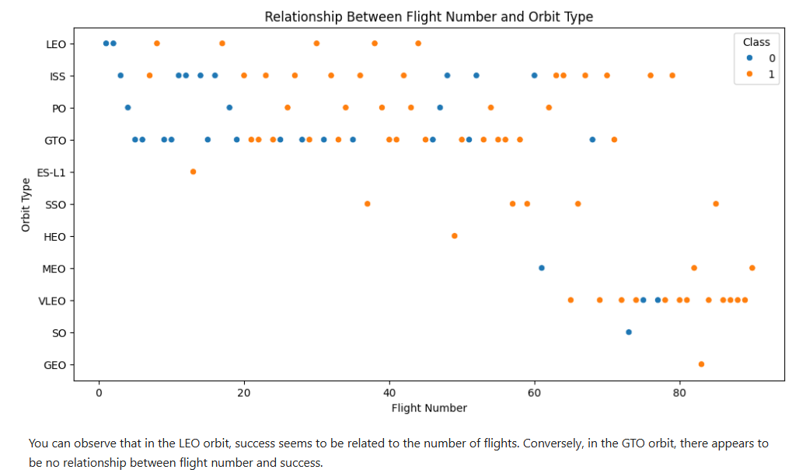
Flight Number vs. Orbit Type

Slide 24
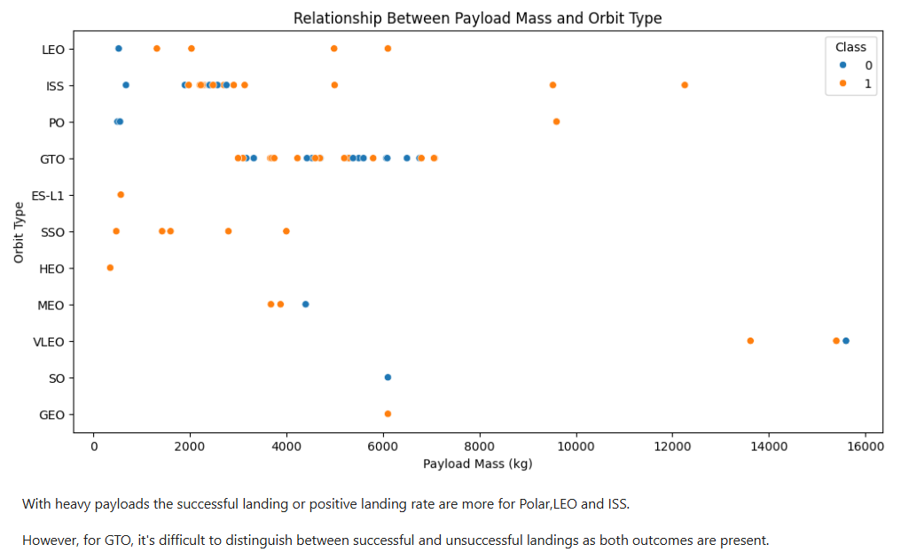
Payload vs. Orbit Type

Slide 25
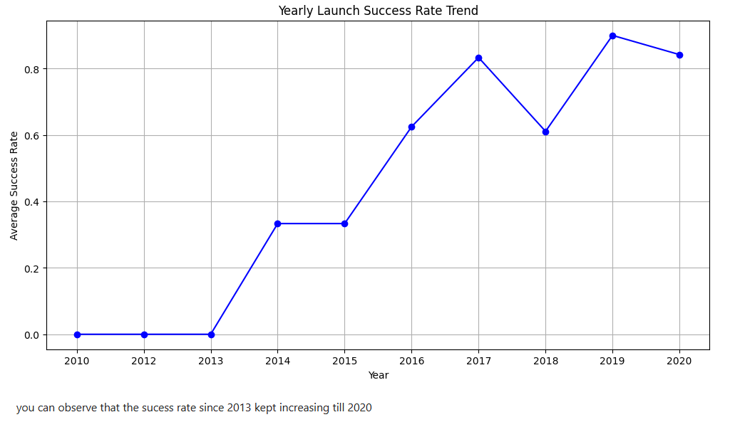
Launch Success Yearly Trend

Slide 26
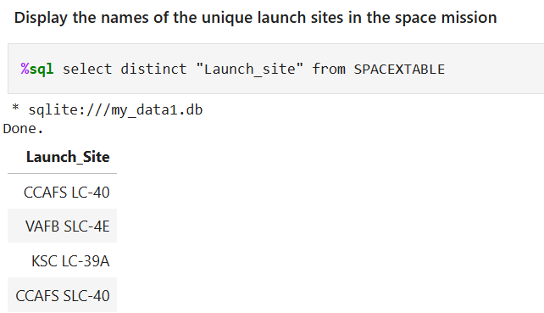
All Launch Site Names
The above query returned a list of unique launch sites present in the SPACEXTABLE.

Slide 27
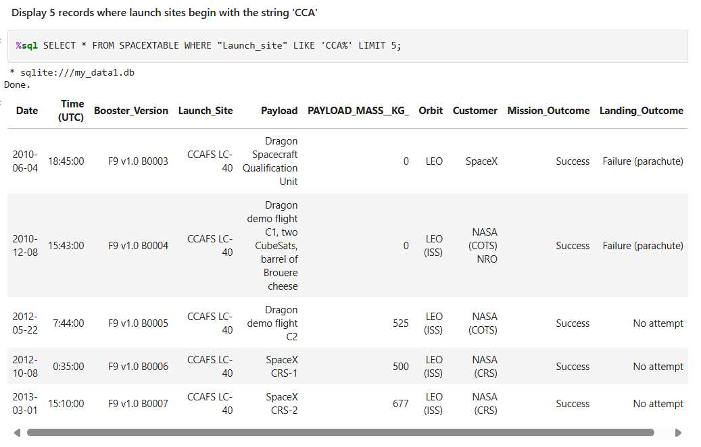
Launch Site Names Begin with 'CCA'
The provided SQL query is designed to retrieve the first 5 records from the SPACEXTABLE where the launch site begins with the string "CCA".

Slide 28
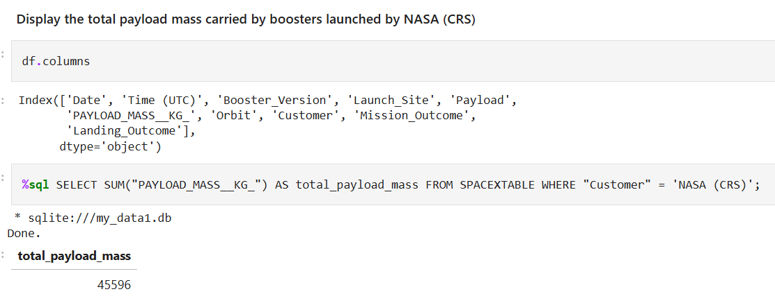
Total Payload Mass
The provided SQL query is designed to calculate the total payload mass carried by boosters launched by NASA (CRS).

Slide 29
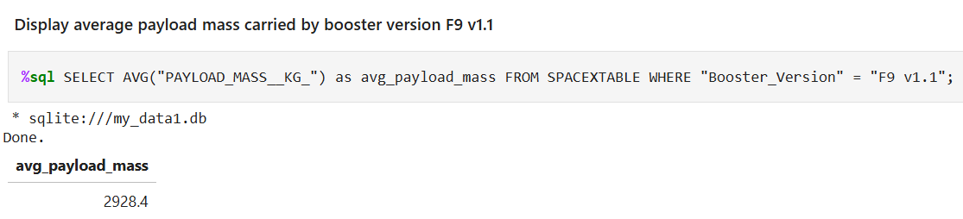
Average Payload Mass by F9 v1.1
The provided SQL query is designed to calculate the average payload mass carried by the booster version "F9 v1.1".

Slide 30
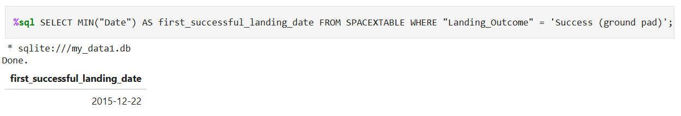
First Successful Ground Landing Date
The provided SQL query is designed to retrieve the first date of a successful ground pad landing from the SPACEXTABLE

Slide 31
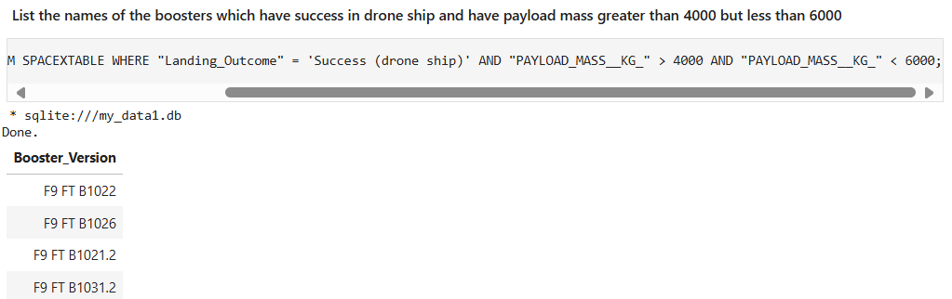
Successful Drone Ship Landing with Payload between 4000 and 6000
The provided SQL query is designed to retrieve the names of the boosters that have successfully landed on a drone ship and carried a payload mass greater than 4000 kilograms but less than 6000 kilograms.

Slide 32
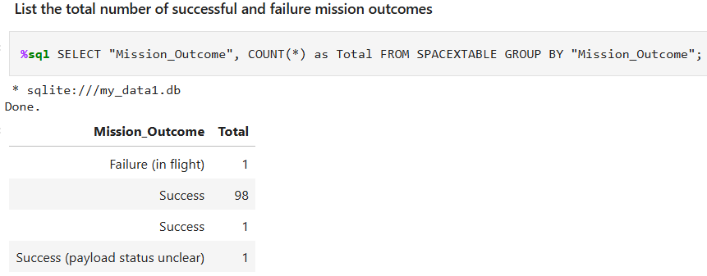
Total Number of Successful and Failure Mission Outcomes
The provided SQL query is designed to count the number of occurrences of each unique mission outcome in the SPACEXTABLE.

Slide 33
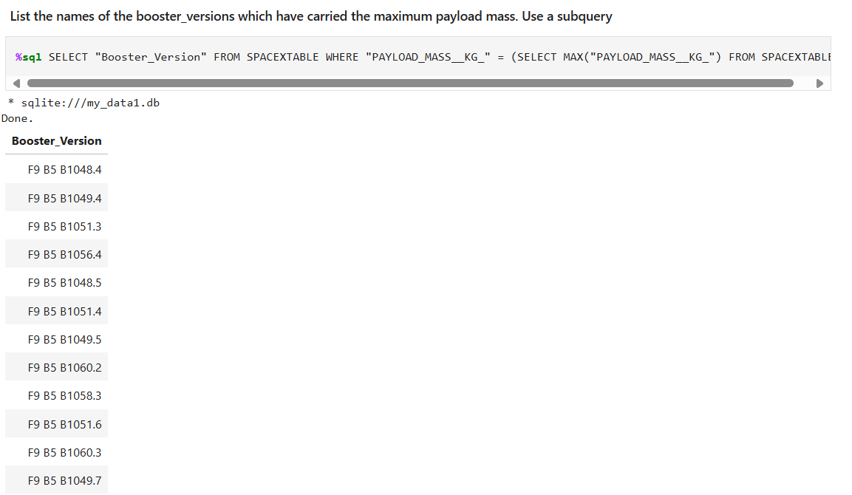
Boosters Carried Maximum Payload
The provided SQL query is designed to retrieve the names of the booster versions that have carried the maximum payload mass.

Slide 34
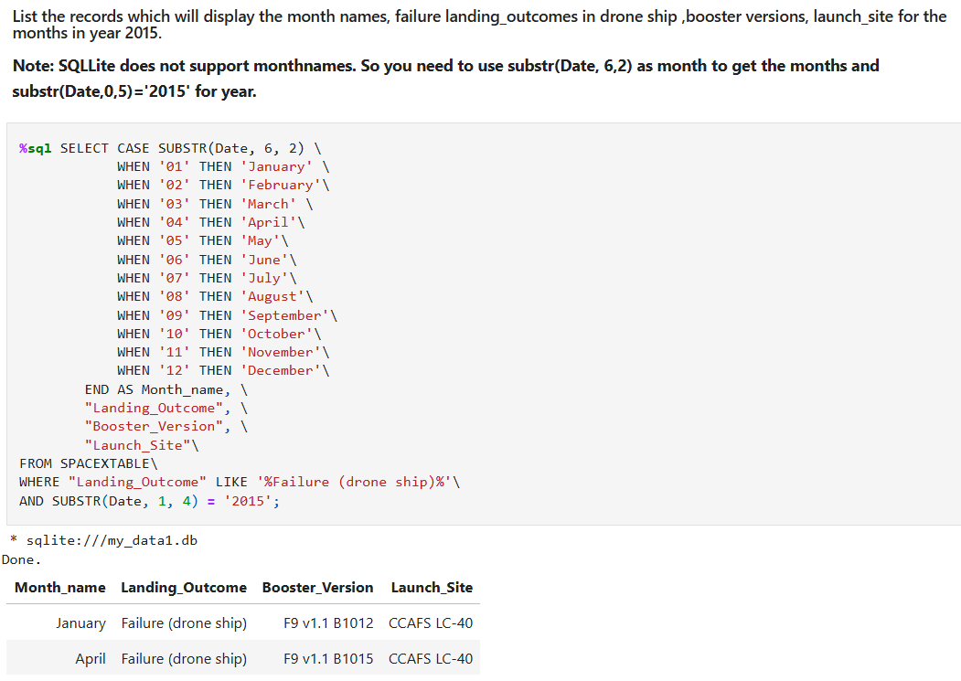
2015 Launch Records
The provided SQL query is designed to retrieve records from the SPACEXTABLE for the year 2015 that meet the following criteria:
Landing Outcome: The landing outcome must be "Failure (drone ship)".
Month: The month must be one of the months in the year 2015.

Slide 35
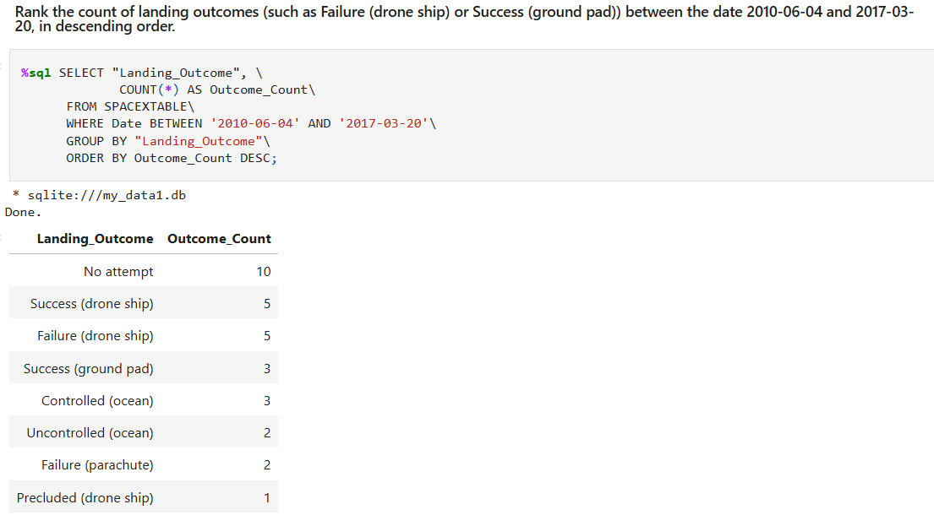
Rank Landing Outcomes Between 2010-06-04 and 2017-03-20
The provided SQL query is designed to count the number of occurrences of each unique landing outcome between the dates 2010-06-04 and 2017-03-20, and then rank them in descending order.

Slide 36

Section 3

Slide 37
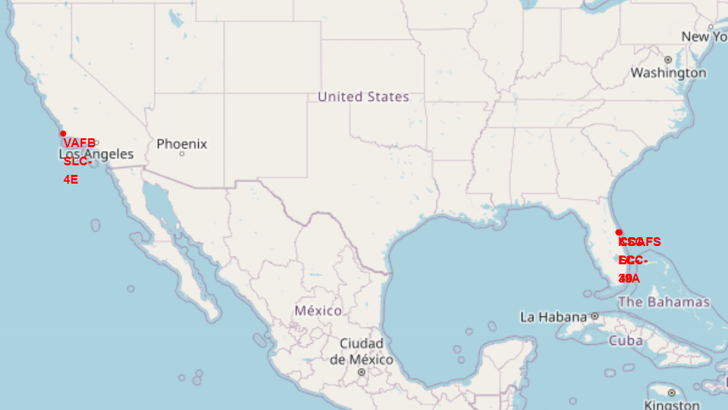
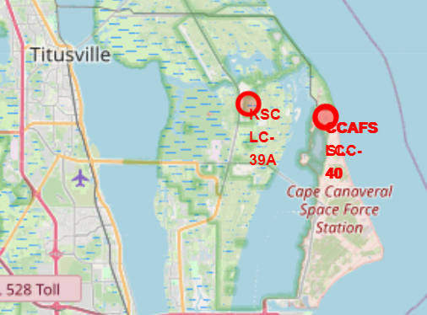
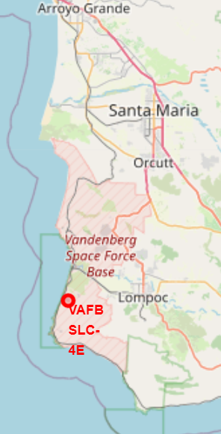
Launch sites on map
Observed that all launch sites in very close proximity to the coast

Slide 38
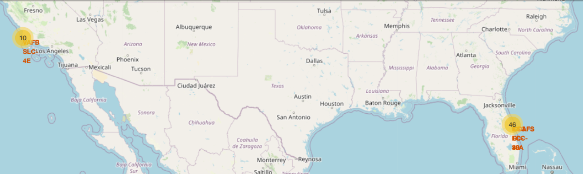
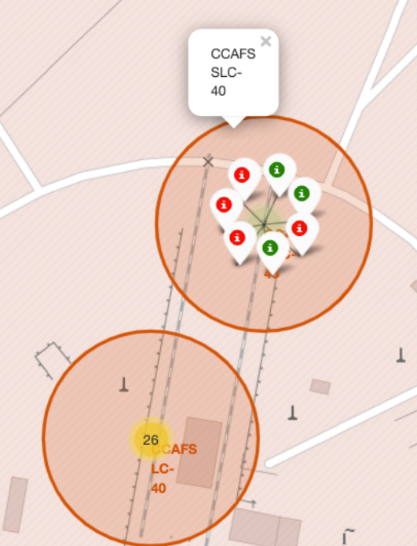
Success/Failed launches on the map
Added a marker cluster to a Folium map and then iterated through the DataFrame to create individual markers based on latitude and longitude coordinates and color information

Slide 39
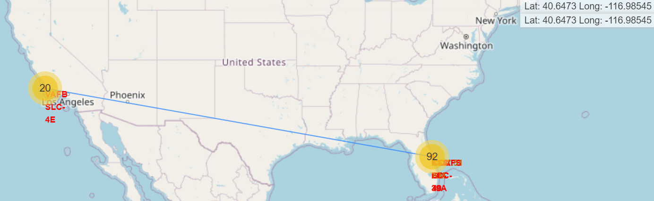
Distances between launch site to its proximities
Drawn a line on a map between two coordinates: a launch site and a coastline point using PolyLine object.

Slide 40

Section 4

Slide 41

SpaceX launch Dashboard
This dashboard application contains input components such as a dropdown list and a range slider to interact with a pie chart and a scatter point chart

Slide 42
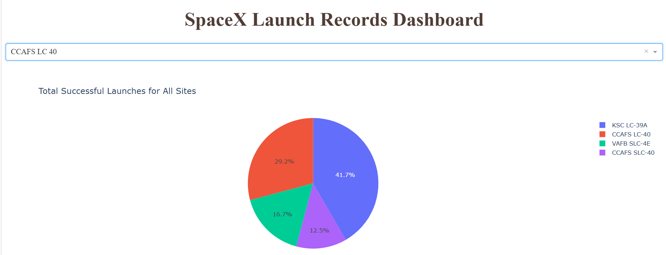
SpaceX Launch Records Dashboard
PieChart shows the total successful launch of all sites

Slide 43
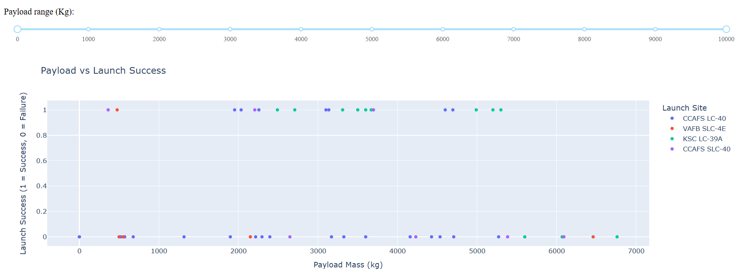
PayLoad Vs Launch Success
CCAFS LC-40 has the most successful launches
The payload range between 3000 kg and 4000 kg appears to have the highest success rate.

Slide 44

Section 5

Slide 45
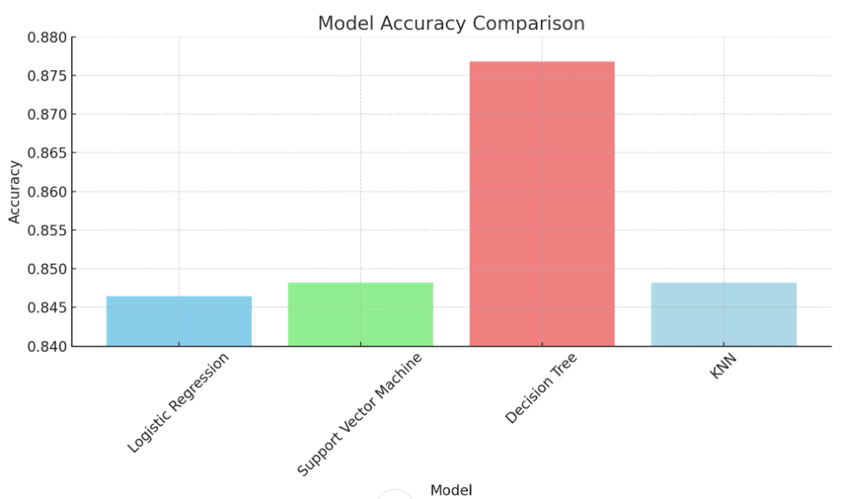
Classification Accuracy
Model: Decision Tree
Accuracy : 0.876786

Slide 46

Confusion Matrix
Confusion Matrix of best performing model :
Model: Decision Tree
Accuracy : 0.876786

Slide 47
Conclusions
Successful Prediction of First Stage Landing: The project successfully demonstrated the use of machine learning models to predict the successful landing of the Falcon 9 first stage, helping to assess SpaceX’s cost-efficiency in rocket launches.
Model Performance Evaluation: Among the models tested, the Decision Tree classifier had the highest accuracy at 87.68%, closely followed by other models like Support Vector Machine (84.82%) and K-Nearest Neighbors (84.82%).
Feature Importance: Key features contributing to the prediction accuracy included payload mass, launch site, and booster version, highlighting their importance in determining the likelihood of a successful landing.
Business Impact: By predicting the outcome of a Falcon 9 first-stage landing, companies can make informed bidding decisions, ensuring cost-competitive space missions in comparison to traditional space providers.
Future Scope: Further improvements can be achieved by incorporating additional variables such as weather conditions, and by fine-tuning hyperparameters to optimize model performance.
Generalization Potential: The models built in this project can be extended to other types of space missions or rockets, enabling a broader range of applications in aerospace analytics.

Slide 48
Appendix
Uploaded all the Python Scripts in GitHub Repository.
GitHub URL:
https://github.com/josliniyda27/DS_SpaceX.git

Slide 49


